Slide 1

AP Biology
Teacher: Mr. Garcia
Room: 7-10

Slide 2


Slide 3

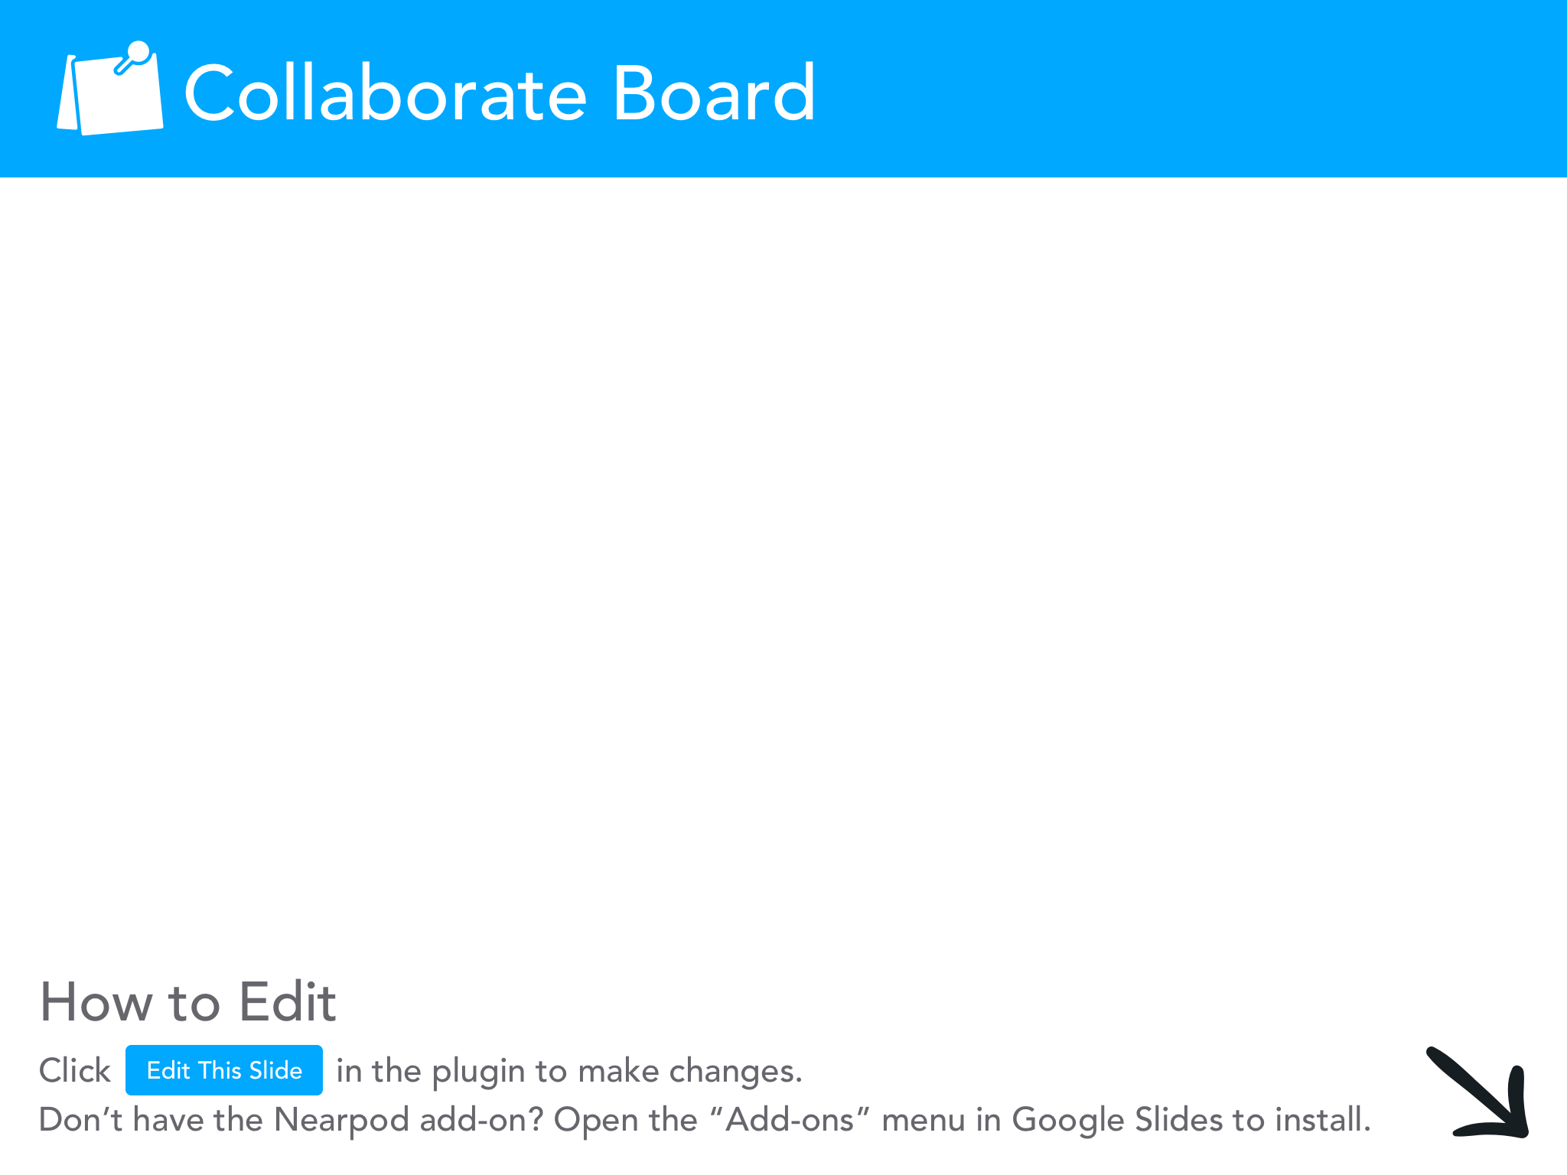

Slide 4

Course Syllabus
AP Biology Description
  Introductory college-level one year course
  Laboratory activities, projects, textbook material, models, diagrams, journal writings, and clinical studies
  Apply to medical field careers and biological research careers
AP Biology Objective
  Apply to standards that focus on the following eight units:
    Chemistry of Life
    Cell Structure and Function
    Cellular Energetics
    Cell Communication and Cell Cycle
    Heredity
    Gene Expression and Regulation
    Natural Selection
    Ecology

Slide 5

Course Objectives
You will be able to:
Appreciate the study of life
Identify and understand unifying principles within a diversified biological world
Understand the process of inquiry
Develop critical thinking skills
Understand biological issues that impacts lives

Slide 6

4 Big Ideas
Big Idea 1: Evolution
Big Idea 2: Energetics
Big Idea 3: Information Storage and
Transmission
Big Idea 4: Systems Interactions

Slide 7
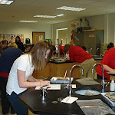
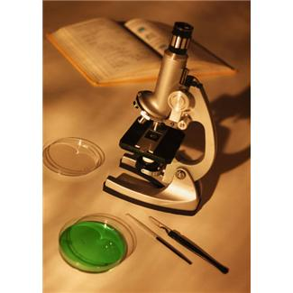
AP Biology:
Fascinating and Fun!

Slide 8



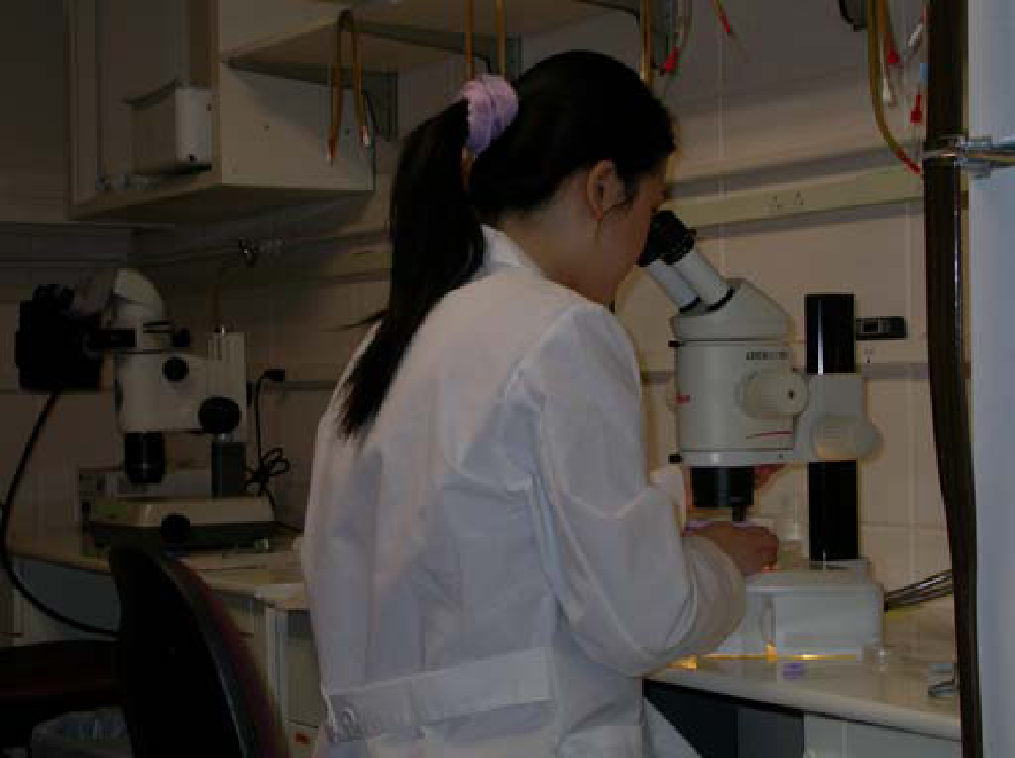

Why Study AP Biology?
Prepared for college
Health careers
Biological research careers

Slide 9

Classroom Materials
Biology for the AP Course (Textbook)
AP Biology Notebook
Chromebook
Notebook (3-Ring Binder)
Writing tools (#2 pencil, blue or black pen)
College-Ruled paper
Drawing paper
Graph paper
Colored pencils, markers or crayons
Highlighters
Glue stick
Ruler
Scissors
Index cards (3 x 5)
4- Function Calculator or
Graphing Calculator
Classroom WebSites:
www.sausd.us/valley
classroom.google.com
Canvas website

Slide 10

Classroom Rules
In order to effectively learn in class, students must
obey the following rules:
Be in assigned seat before the tardy bell rings.
Bring notebook, chromebook, and pencil/pen to class.
Turn in assignments neatly and on time.
Treat peers and teacher with courtesy and respect.
Listen attentively to teacher and peers when speaking or giving directions.
Conduct safety rules at all times.

Slide 11


Discipline Plan
Rewards for following rules:
  Verbal and/or Written Praise.
  Given Extra Credit.
  Receive Token Awards.
  Receive Outstanding Citizenship.
Consequences for not following the rules:
  1st offense = Verbal Warning
  2nd offense = Teacher Conference and/or Seat
Change
  3rd offense = Phone Call Home
  4th offense = Behave Out and Parent
  Conference

Slide 12

Grades
Assignments and Homework
Laboratory Reports and Projects
Assignment Notebook
Quizzes/Unit Exams
Citizenship (Attendance and Behavior)
Extra Credit

Slide 13

Grading Scale
90% - 100% | A
80% - 89% | B
70% - 79% | C
60% - 69% | D
0% - 59% | F

Slide 14
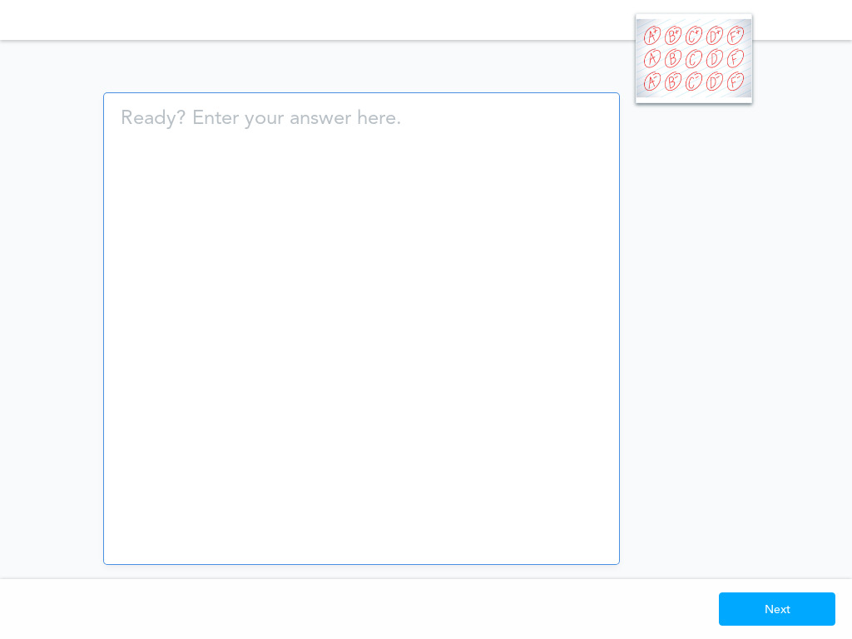
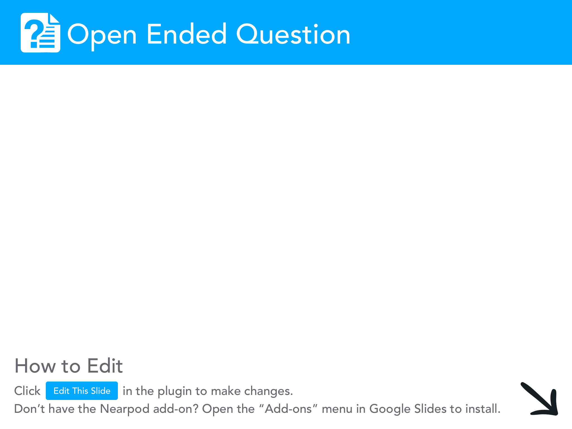

Slide 15
Teaching Only Happens with Attendance!
Regular attendance is important to success
Only reasons for absence:
    Illness (we need a note and a phone call!)
    Medical/Dental Appointments (after school, please!)
    Court Appearances (notice in advance)
    Death in the Family (let us help with grieving)
PLEASE, A PHONE CALL AND A NOTE BOTH….ALWAYS!!
ATTENDANCE OFFICE: (714) 241-6410

Slide 16

Absences
You must bring an excused note or phone call to the attendance office to clear your absence. You are responsible for making up any work that you have missed. If you are absent on the day an assignment is due, you must turn it in on the day you return.

Slide 17

Academic Honesty
It is your job to convince me that you are not cheating. Ways to convince me:
  Keep Your Eyes On Your Own Paper or Chromebook Screen.
  Keep Your Answer Sheet or Chromebook Screen Covered.
  Avoid Copying from Online Websites and Resources
If I Suspect that you are cheating, the following will take place:
  1st time X on paper (10 points off)
  2nd time 0% on test, quiz or homework assignment
  3rd time: 0% and an office referral

Slide 18
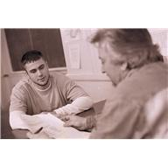
Tutoring
Tutoring is available before or after school by appointment.
It is also available in the NAC and Falcon Club.

Slide 19

Parent/Guardian Signature
First Homework Assignment (5 pts.)
  Parent/Guardian Signature With Date
  Student Signature With Date

